Slide 1
Introduction
June 2018
Christina Maimone
Research Computing Services
christina.maimone@northwestern.edu

Slide 2
Workshop Materials
Handout
Cheat Sheet
Reference Card
Get Ready
Download Files: see handout
Open RStudio (desktop or cloud)

Slide 3
Christina Maimone
Research Computing Services
http://www.it.northwestern.edu/research/

Slide 4
Afternoon Practice
1:30pm
Mudd Library
Large Classroom 2210

Slide 5
Sign In Please
Coffee, tea, etc.
Break about half way through
Help during exercises: ask neighbors, flag us down

Slide 6

Introductions
Say hello to your neighbors

Slide 7
What is R? Why R?
RStudio Tour
Analysis Example Introduction
Basics and Data Types
Data Structures
Reading and Writing Files
Data Manipulation and Statistics
Visualization
Functions, Loops, and Conditionals

Slide 8
What is ?
free
software environment
for statistical computing
and graphics

Slide 9
What is ?
1) A company
2) A software program that makes working in R easier
IDE: Integrated Development Environment

Slide 10
Why R?
Full programming language
Can use as an application
Designed for data analysis

Slide 11
Why R?
Customizable, extensible
Contributed packages

Slide 12
Why R?
Support for reproducible analysis
Widely used
R Community
Notes:
The fact that it's free helps with reproducibility

Slide 13
R Community
#rstats
Northwestern R User Group: http://bit.ly/nu_r
https://rladies.org/
RStudio Community https://community.rstudio.com/
R Bloggers https://www.r-bloggers.com/

Slide 14
Shiny
http://wordbank.stanford.edu/analyses?name=vocab_norms

Slide 15
R Markdown
Exercise files
https://rmarkdown.rstudio.com/gallery.html

Slide 16
Things to Know About R

Slide 17
Things to Know
"R" refers to both the language and
the environment (application)

Slide 18
Things to Know
R runs in memory,
objects loaded in memory

Slide 19
Things to Know
It's expected that you'll
install and use additional packages
Notes:
In this workshop, focused on core R functions — called base R, with just a few exceptions to learn how to use packages. Why? 1) foundation, 2) learn how to read other people's code. I tend to use other packages when doing my own analysis — tidyverse set of packages, which includes dplyr for data manipulation and ggplot2 for visualization, among others.

Slide 20
Things to Know
Packages are open source
and user contributed →
use established packages
or evaluate quality

Slide 21
Things to Know
There are multiple ways
to do most things

Slide 22
Things to Know
There are multiple ways
to do most things
Some ways are better than others

Slide 23
Things to Know
You can, and often will, have more than one dataset open in R
at the same time

Slide 24
Things to Know
Most operations are done by calling functions
function_name(unnamed_argument_value,
named_argument=value)

Slide 25
print("Hello World")
print(x="Hello World")
Notes:
"Hello World" is an argument to the function print. If not named, the order of arguments matters

Slide 26
Things to Know
R functions don't* change the value of a variable or dataset
* generally, under normal circumstances
Notes:
Pass by value - what does this mean? (onto next…)

Slide 27
myvector <- sort(myvector)

Slide 28
Assignment Operator
myvector <- sort(myvector)

Slide 29
Things to Know
Run R in multiple ways:
Interactively: R console, RStudio, Jupyter Notebooks
Batch jobs

Slide 30
What is R? Why R?
RStudio Tour
Analysis Example Introduction
Basics and Data Types
Data Structures
Reading and Writing Files
Data Manipulation and Statistics
Visualization
Functions, Loops, and Conditionals
Notes:
What are we learning today and why
read other code
don't miss some of the basics —> leads to errors later, harder to learn new things on your own
Day 1 basics — more like learning programming than data analysis - learn the pieces to build up to things

Slide 31

Exercise
Pick a number ➡️ Save it as x
Multiply x by 3
Take the log of the above
Subtract 4 from the above
Square the above

Slide 32
x <- 13
x*3
log(x*3)
log(x*3)-4
(log(x*3)-4)^2

Slide 33

Exercise
Install the following packages using
the RStudio interface:
qdapTools
car
Load the car library
Install the tidyverse package.
It may take a while to complete.

Slide 34
install.packages("qdapTools")
install.packages("tidyverse")
install.packages("car")
library(car)
install.packages(c("qdapTools", "tidyverse",
"car"))

Slide 35
Packages
Be judicious in loading packages
Same function name in multiple packages
package_name::function_name()

Slide 36
What is R? Why R?
RStudio Tour
Analysis Example Introduction
Basics and Data Types
Data Structures
Reading and Writing Files
Data Manipulation and Statistics
Visualization
Functions, Loops, and Conditionals

Slide 37
Data
Studying African Farmer-Led Irrigation (SAFI)
Survey data - a subset of variables
Notes:
We're going to start by running a short example of some simple analysis on a data set. At this point, you won't know what the code means — that's ok. We're going to come back to this example as we learn parts of R, and by the end of the workshop, you'll understand what everything is doing.

Slide 38
key_id | Added to provide a unique Id for each observation. (The InstanceID field does this as well but it is not as convenient to use)
village | Village name
interview_date | Date of interview
no_membrs | How many members in the household?
years_liv | How many years have you been living in this village or neighboring village?
respondent_wall_type | What type of walls does their house have (from list)
rooms | How many rooms in the main house are used for sleeping?
memb_assoc | Are you a member of an irrigation association?
affect_conflicts | Have you been affected by conflicts with other irrigators in the area?
liv_count | Number of livestock owned.
items_owned | Which of the following items are owned by the household? (list)
no_meals | How many meals do people in your household normally eat in a day?
months_lack_food | Indicate which months, In the last 12 months have you faced a situation when you did not have enough food to feed the household?
instanceID | Unique identifier for the form data submission

Slide 39
library(lubridate)
library(qdapTools)
safi <- read.csv("data/SAFI_clean.csv",
na = c("", "NULL", "NA"),
stringsAsFactors = FALSE)
safi$village <- factor(safi$village)
safi$respondent_wall_type <- factor(trimws(safi$respondent_wall_type)) safi$affect_conflicts <- factor(safi$affect_conflicts, ordered=TRUE,
levels=c("never","once","more_once","frequently"))
safi$interview_date <- ymd_hms(safi$interview_date)
safi$memb_assoc <- ifelse(is.na(safi$memb_assoc), NA,
ifelse(safi$memb_assoc == "yes", TRUE, FALSE))
month_indicators <- mtabulate(strsplit(safi$months_lack_food, ";"))
month_indicators <- month_indicators[,-10]
names(month_indicators) <- substr(names(month_indicators), 0, 3)
month_indicators <- month_indicators[,month.abb]
safi <- cbind(safi, month_indicators)
safi$months_lack_food_count <- apply(month_indicators, 1, sum)

Slide 40
apply(month_indicators, 2, sum)
which.max(apply(month_indicators, 2, sum))
table(safi$village)
tapply(safi$months_lack_food_count, safi$village, mean)
t.test(safi$months_lack_food_count[safi$village == "Chirodzo"],
safi$months_lack_food_count[safi$village == "Ruaca"])
barplot(table(safi$no_membrs))
hist(safi$no_membrs, breaks=1:20-.5, col="gray",
main="Family Size", xlab="Number of Members",
ylab="Number of Families")
boxplot(no_membrs~village, data=safi)
plot(y=safi$months_lack_food_count, x=safi$no_membrs) plot(y=jitter(safi$months_lack_food_count), x=jitter(safi$no_membrs),
col=rgb(.1, 0, 1, alpha=.3), pch=16)

Slide 41
library(lubridate)
library(qdapTools)
safi <- read.csv("data/SAFI_clean.csv",
na = c("", "NULL", "NA"),
stringsAsFactors = FALSE)
safi$village <- factor(safi$village)
safi$respondent_wall_type <- factor(trimws(safi$respondent_wall_type)) safi$affect_conflicts <- factor(safi$affect_conflicts, ordered=TRUE,
levels=c("never","once","more_once","frequently"))
safi$interview_date <- ymd_hms(safi$interview_date)
safi$memb_assoc <- ifelse(is.na(safi$memb_assoc), NA,
ifelse(safi$memb_assoc == "yes", TRUE, FALSE))
month_indicators <- mtabulate(strsplit(safi$months_lack_food, ";"))
month_indicators <- month_indicators[,-10]
names(month_indicators) <- substr(names(month_indicators), 0, 3)
month_indicators <- month_indicators[,month.abb]
safi <- cbind(safi, month_indicators)
safi$months_lack_food_count <- apply(month_indicators, 1, sum)

Slide 42
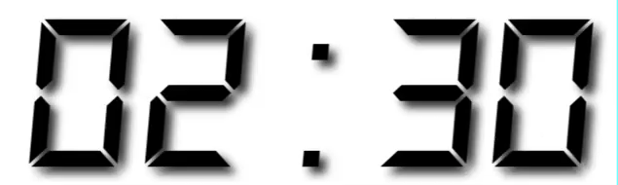
Exercise A
Run the code in exercises/exerciseA.R
line by line
Talk with those around you if you need help!

Slide 43
What is R? Why R?
RStudio Tour
Analysis Example Introduction
Basics and Data Types
Data Structures
Reading and Writing Files
Data Manipulation and Statistics
Visualization
Functions, Loops, and Conditionals

Slide 44
Arithmetic
2 + 2
5 %% 2
3.452 * 6
2^4
(3 + 4)*6

Slide 45
Functions
log(10)
log(16, base=2)
sqrt(10)
exp(10)
sin(1)
Notes:
We've already called a few functions. There are lots of common built in functions, additional functions in packages, and you can write your own functions.
Unnamed arguments - order matters; named arguments can be in any order
Functions are objects — they can be passed as arguments to other functions

Slide 46
Nesting Functions
log(exp(3))
sin(asin(sin(pi/2)))

Slide 47
Comparisons
1 < 2
TRUE == FALSE
'a' != "Boy"
Notes:
TRUE and FALSE - boolean values, all caps, full word.
== for testing for equality; singe = for function arguments — will also assign values to variables, but don't do it
Strings (text) with single or double quotes

Slide 48
Logical Operators
TRUE & FALSE
!TRUE & FALSE
TRUE | FALSE
(2 > 1) & (3 > 2)
FALSE
FALSE
TRUE
TRUE
Notes:
& is and
| is OR
What will these produce? False, False, true, true

Slide 49
Variables
x <- 4
x <- 3 + 4 + 7
x = 3
Notes:
The right hand side of the assignment can be any valid R expression. The right hand side is fully evaluated before the assignment occurs.
Variable names can contain letters, numbers, underscores and periods. They cannot start with a number; they should not start with an underscore or period in regular use. They cannot contain spaces. Different people use different conventions for long variable names
Everything is an object

Slide 50
Variable Names
Start with a letter
Contain letters, numbers, underscore, period
Case sensitive
Different conventions used (be consistent):
underscores_between_words
periods.between.words
camelCaseToSeparateWords
use this
Notes:
Could start with underscore or period, but don't do this in regular use

Slide 51
Data Types
logical: TRUE or FALSE
integer
numeric aka double: real, decimal
complex: example 2+5i
character: "text data" - single or double quotes
use paste() to concatenate (join)
typeof() to check type
Notes:
These are the core types for single values — there are a few others: NULL, closure (function)

Slide 52
Vectors
x <- 1:5
x <- c(1, 2, 3, 4, 5)
x <- c("apple", "banana")
x <- c(TRUE, FALSE, TRUE)
Notes:
C is a function
Don't ever call a variable c or you're going to confuse R a lot

Slide 53
Vectors
Only have one type of data!
One dimensional (can't be nested)
All data will be converted to lowest type on list:
logical
integer
numerical
complex
character

Slide 54
Vectors
x <- c(TRUE, 2, 3.4)
1.0 2.0 3.4
x <- c(4, "alpha", TRUE)
"4" "alpha" "TRUE"

Slide 55
Vectors
x <- 1:5
x+1
2 3 4 5 6
x*x
1 4 9 16 25

Slide 56
Vectors
x <- 2:6
x
2 3 4 5 6
x <- c(x, 10, 11)
2 3 4 5 6 10 11

Slide 57
Vectors
x <- 2:6
c(x, x)
2 3 4 5 6 2 3 4 5 6
x<- c(x, c(7, 8), 9)
2 3 4 5 6 7 8 9

Slide 58
Vectors and Functions
x <- 1:5
log(x)
0.00000 0.69314 1.09861 1.38629 1.60943
mean(x)
3
Notes:
Some functions take vectors as arguments, others apply to each element of a vector. How to tell the difference? We'll learn how to read the documentation soon.

Slide 59
Named Vectors
> x <- c(10, 13, 9)
> x
[1] 10 13 9
> names(x) <- c("Ohio", "Illinois", "Indiana")
> x
Ohio Illinois Indiana
10 13 9
Notes:
You usually don't name them yourself, but some functions returned named vectors. May look weird, because there's a function call on the left hand side. But you can assign values to some functions.

Slide 60
library(lubridate)
library(qdapTools)
safi <- read.csv("data/SAFI_clean.csv",
na = c("", "NULL", "NA"),
stringsAsFactors = FALSE)
safi$village <- factor(safi$village)
safi$respondent_wall_type <- factor(trimws(safi$respondent_wall_type)) safi$affect_conflicts <- factor(safi$affect_conflicts, ordered=TRUE,
levels=c("never","once","more_once","frequently"))
safi$interview_date <- ymd_hms(safi$interview_date)
safi$memb_assoc <- ifelse(is.na(safi$memb_assoc), NA,
ifelse(safi$memb_assoc == "yes", TRUE, FALSE))
month_indicators <- mtabulate(strsplit(safi$months_lack_food, ";"))
month_indicators <- month_indicators[,-10]
names(month_indicators) <- substr(names(month_indicators), 0, 3)
month_indicators <- month_indicators[,month.abb]
safi <- cbind(safi, month_indicators)
safi$months_lack_food_count <- apply(month_indicators, 1, sum)

Slide 61
Exercise B
Open exercises/exerciseB.R
Use the cheat sheet and reference card to help you with the exercises.
Work with those around you 🙂

Slide 62
> set.seed(1234)
>
> x1 <- rnorm(5)
> x1
[1] -1.2070657 0.2774292 1.0844412 -2.3456977 0.4291247
>
> x1 < 0
[1] TRUE FALSE FALSE TRUE FALSE
>
> x2 <- rnorm(5, mean=0.5)
> x2
[1] 1.00605589 -0.07473996 -0.04663186 -0.06445200 -0.39003783
>
> max(x1) > max(x2)
[1] TRUE
>
> mean(x1) > mean(x2)
[1] FALSE

Slide 63
Indexing
All R indices start with 1 (not 0)
Select with
Numbers: index positions
Boolean: same length of TRUE/FALSE
Names: for objects with named elements

Slide 64
Indexing Vectors
x <- c("a", "b", "c", "d", "e")
x[1] | "a"
x[1:3] | "a" "b" "c"
x[c(1,2,3)] | "a" "b" "c"
x[-1] | "b" "c" "d" "e"
x[c(5,1)] | "e" "a"
x[x < 'c'] | "a" "b"

Slide 65
Indexing Vectors
x <- c("a", "b", "c")
names(x) <- c("first","second","third")
x["first"] | first "a"
x[c("third", "first")] | third first "c" "a"

Slide 66
Finding Values in Vectors
x <- c("a", "b", "c", "d", "e")
'b' %in% x | TRUE
match(c('b','d','k'), x) | 2 4 NA
which(x == 'b') | 2
length(x) | 5

Slide 67

Exercise B2
Open exercises/exerciseB2.R
Use the cheat sheet and reference card to help you with the exercises.
Work with those around you 🙂

Slide 68
Missing Data
NA
counts <- c(1, 2, NA, 5, NA, 3)
is.na(counts)
FALSE FALSE TRUE FALSE TRUE FALSE

Slide 69
Missing Data
counts <- c(1, 2, NA, 5, NA, 3)
which(is.na(counts))
3 5
sum(is.na(counts))
2

Slide 70
Missing Data
counts <- c(1, 2, NA, 5, NA, 3)
mean(counts)
NA
mean(counts, na.rm=TRUE)
2.75

Slide 71
Missing Data
animals <- c("cow", "pig", "pig",
NA, "cow", NA, "cow")
table(animals)
animals
cow pig
3 2

Slide 72
Missing Data
animals <- c("cow", "pig", "pig",
NA, "cow", NA, "cow")
table(animals, useNA="ifany")
animals
cow pig <NA>
3 2 2

Slide 73
Other Special Values
NULL - undefined, can't be put into a vector
NaN - not a number (0/0)
Inf - infinity (1/0), can be negative

Slide 74
Exercise C
Open exercises/exerciseC.R
animals <- sample(c("pig", "cow", "horse", "duck", NA),
30, replace=TRUE)
Print animals, get the length
Make a table
How many missing elements?
How many elements are not missing?
Drop the missing values

Slide 75
Factors
Categorical data
Values restricted to a specified set (called levels)
Can be ordered
Stored as integers
Generated automatically from text data by some R functions

Slide 76
Factors Demo

Slide 77
Exercise D
Open exercises/exerciseD.R

Slide 78
library(lubridate)
library(qdapTools)
safi <- read.csv("data/SAFI_clean.csv",
na = c("", "NULL", "NA"),
stringsAsFactors = FALSE)
safi$village <- factor(safi$village)
safi$respondent_wall_type <- factor(trimws(safi$respondent_wall_type)) safi$affect_conflicts <- factor(safi$affect_conflicts, ordered=TRUE,
levels=c("never","once","more_once","frequently"))
safi$interview_date <- ymd_hms(safi$interview_date)
safi$memb_assoc <- ifelse(is.na(safi$memb_assoc), NA,
ifelse(safi$memb_assoc == "yes", TRUE, FALSE))
month_indicators <- mtabulate(strsplit(safi$months_lack_food, ";"))
month_indicators <- month_indicators[,-10]
names(month_indicators) <- substr(names(month_indicators), 0, 3)
month_indicators <- month_indicators[,month.abb]
safi <- cbind(safi, month_indicators)
safi$months_lack_food_count <- apply(month_indicators, 1, sum)
Notes:
R help to learn what some of these functions are doing

Slide 79
R Help
Think documentation, not "help"
Generally need to know the name of the function
Other resources
Stackoverflow https://stackoverflow.com/
Google searches
R Seek: https://rseek.org/

Slide 80
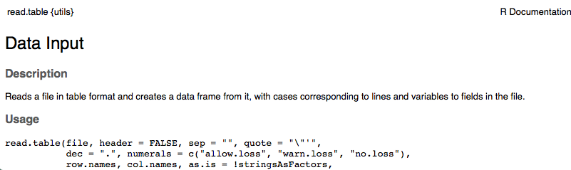
Function
Package
Title

Slide 81
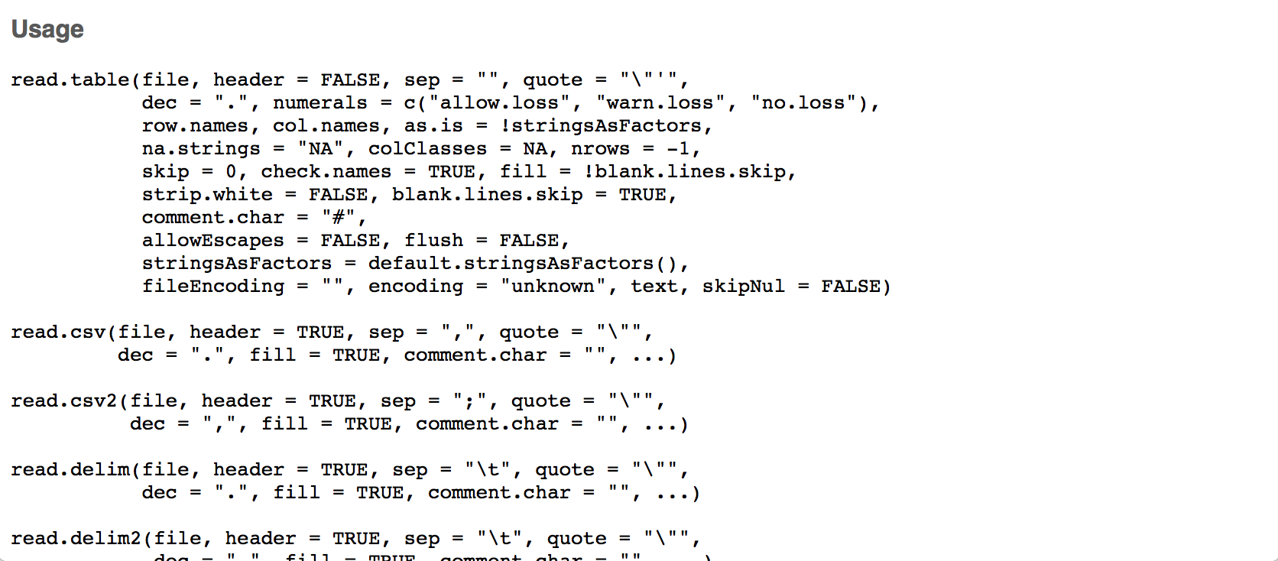

Slide 82
read.table(file, header = FALSE, sep = "", quote = "\"'",
dec = ".", numerals = c("allow.loss", "warn.loss", "no.loss"),
row.names, col.names, as.is = !stringsAsFactors,
na.strings = "NA", colClasses = NA, nrows = -1,
skip = 0, check.names = TRUE, fill = !blank.lines.skip,
strip.white = FALSE, blank.lines.skip = TRUE,
comment.char = "#",
allowEscapes = FALSE, flush = FALSE,
stringsAsFactors = default.stringsAsFactors(),
fileEncoding = "", encoding = "unknown", text, skipNul = FALSE)

Slide 83
read.table(file, header = FALSE, sep = "", quote = "\"'",
dec = ".", numerals = c("allow.loss", "warn.loss", "no.loss"),
row.names, col.names, as.is = !stringsAsFactors,
na.strings = "NA", colClasses = NA, nrows = -1,
skip = 0, check.names = TRUE, fill = !blank.lines.skip,
strip.white = FALSE, blank.lines.skip = TRUE,
comment.char = "#",
allowEscapes = FALSE, flush = FALSE,
stringsAsFactors = default.stringsAsFactors(),
fileEncoding = "", encoding = "unknown", text, skipNul = FALSE)

Slide 84
read.table(file, header = FALSE, sep = "", quote = "\"'",
dec = ".", numerals = c("allow.loss", "warn.loss", "no.loss"),
row.names, col.names, as.is = !stringsAsFactors,
na.strings = "NA", colClasses = NA, nrows = -1,
skip = 0, check.names = TRUE, fill = !blank.lines.skip,
strip.white = FALSE, blank.lines.skip = TRUE,
comment.char = "#",
allowEscapes = FALSE, flush = FALSE,
stringsAsFactors = default.stringsAsFactors(),
fileEncoding = "", encoding = "unknown", text, skipNul = FALSE)

Slide 85
read.csv(file, header = TRUE, sep = ",", quote = "\"",
dec = ".", fill = TRUE, comment.char = "", ...)

Slide 86
read.csv(file, header = TRUE, sep = ",", quote = "\"",
dec = ".", fill = TRUE, comment.char = "", ...)
read.table(file, header = FALSE, sep = "", quote = "\"'",
dec = ".", fill = !blank.lines.skip,
comment.char = "#",

Slide 87
read.csv(file, header = TRUE, sep = ",", quote = "\"",
dec = ".", fill = TRUE, comment.char = "", ...)
read.table(file, header = FALSE, sep = "", quote = "\"'",
dec = ".", fill = !blank.lines.skip,
comment.char = "#",

Slide 88
read.csv(file, header = TRUE, sep = ",", quote = "\"",
dec = ".", fill = TRUE, comment.char = "", ...)
read.table(file, header = FALSE, sep = "", quote = "\"'",
dec = ".", fill = !blank.lines.skip,
comment.char = "#",

Slide 89
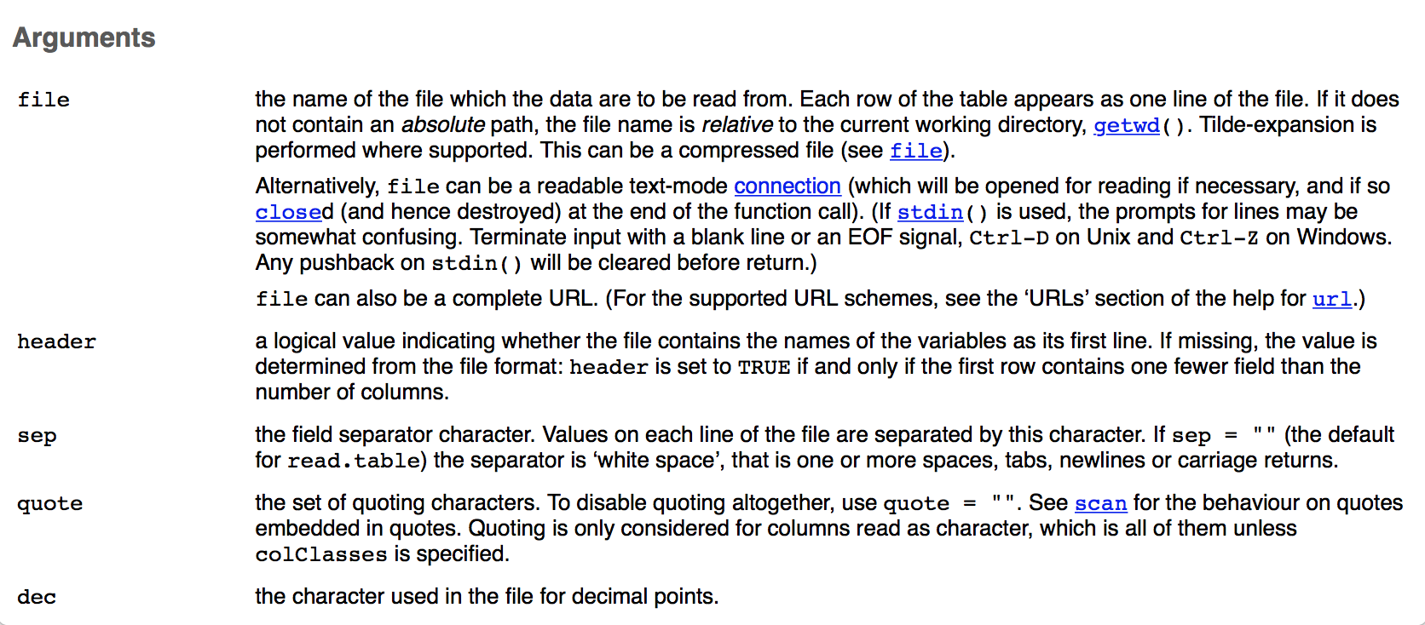

Slide 90
header | a logical value indicating whether the file contains the names of the variables as its first line. If missing, the value is determined from the file format: header is set to TRUE if and only if the first row contains one fewer field than the number of columns.
sep | the field separator character. Values on each line of the file are separated by this character. If sep = "" (the default for read.table) the separator is ‘white space’, that is one or more spaces, tabs, newlines or carriage returns.
na.strings | a character vector of strings which are to be interpreted as NA values. Blank fields are also considered to be missing values in logical, integer, numeric and complex fields. Note that the test happens after white space is stripped from the input, so na.strings values may need their own white space stripped in advance.
stringsAsFactors | logical: should character vectors be converted to factors? Note that this is overridden by as.is and colClasses, both of which allow finer control.
strip.white | logical. Used only when sep has been specified, and allows the stripping of leading and trailing white space from unquoted character fields (numeric fields are always stripped). See scan for further details (including the exact meaning of ‘white space’), remembering that the columns may include the row names.

Slide 91
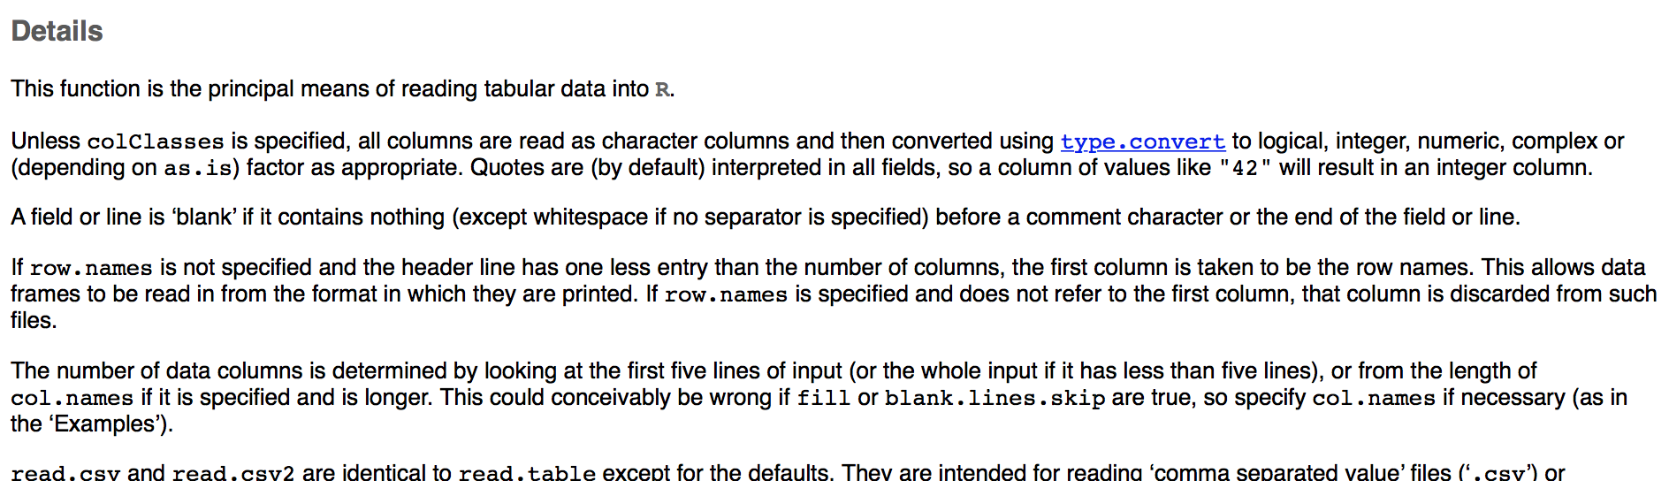
"Details": more details than you usually
need about how the function does what
it does

Slide 92
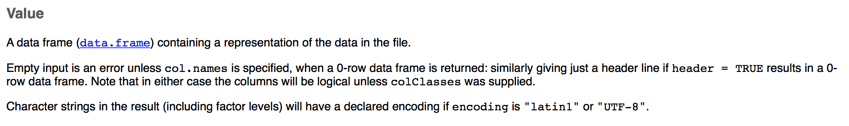
Value: What does this function return
to you? What is the output?

Slide 93
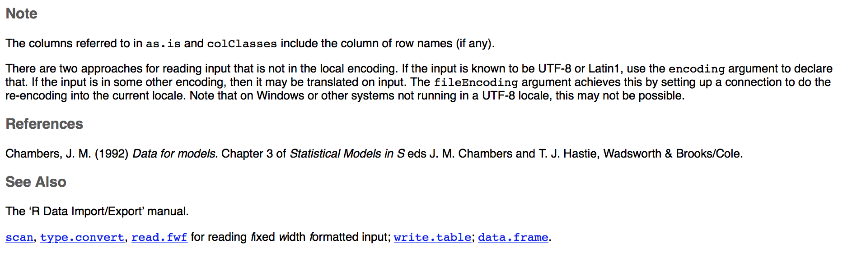
Note: Special cases or behaviors
See Also: Related functions

Slide 94
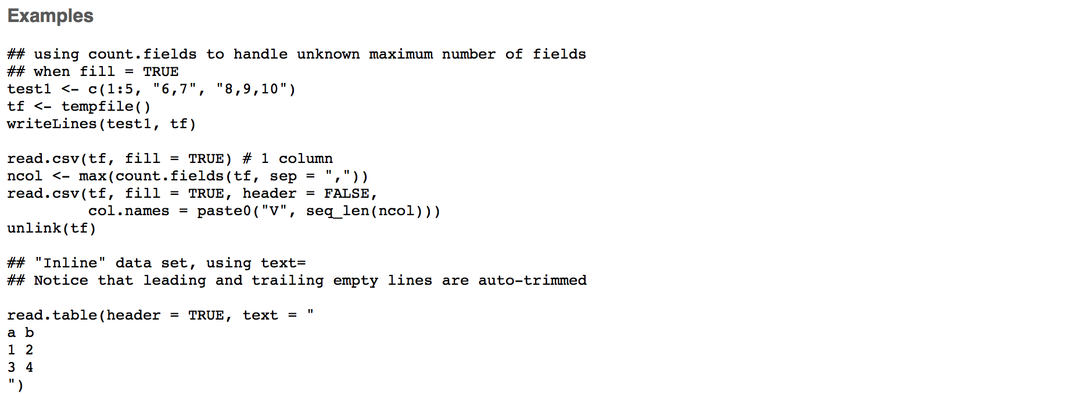
Examples: How do you use this?

Slide 95
Help
?table
example("table")

Slide 96
Exercise
Look at the help for the following functions to see what they do:
trimws
strsplit
substr
Try them out to experiment

Slide 97
library(lubridate)
library(qdapTools)
safi <- read.csv("data/SAFI_clean.csv",
na = c("", "NULL", "NA"),
stringsAsFactors = FALSE)
safi$village <- factor(safi$village)
safi$respondent_wall_type <- factor(trimws(safi$respondent_wall_type)) safi$affect_conflicts <- factor(safi$affect_conflicts, ordered=TRUE,
levels=c("never","once","more_once","frequently"))
safi$interview_date <- ymd_hms(safi$interview_date)
safi$memb_assoc <- ifelse(is.na(safi$memb_assoc), NA,
ifelse(safi$memb_assoc == "yes", TRUE, FALSE))
month_indicators <- mtabulate(strsplit(safi$months_lack_food, ";"))
month_indicators <- month_indicators[,-10]
names(month_indicators) <- substr(names(month_indicators), 0, 3)
month_indicators <- month_indicators[,month.abb]
safi <- cbind(safi, month_indicators)
safi$months_lack_food_count <- apply(month_indicators, 1, sum)
Notes:
read.csv, trimws, strsplit, subset
but we still don't know what safi is — what we read our data into, because we haven't learned about anything yet that can hold a csv.
A few left over things about the R environment, then on to data frames

Slide 98
Workspace
All of the objects in your environment
ls()
Can all be saved in one file together (and loaded later)
save.image("20180626.RData")
List of loaded libraries is NOT saved
Remove an object from environment
rm(x)
Asked about saving image each time you quit R
If yes, saves ".RData", which gets reloaded next session

Slide 99
Working Directory
Where does R think it is? What directory?
Determines path for reading and writing files
Can set the working directory
Better to use RStudio projects
Working directory is where the .Rproj file is
Keep all files contained in one directory
Makes it easier to share code
Notes:
Not using RStudio? Still keep code in a single directory, then start R from that directory - command line

Slide 100
What is R? Why R?
RStudio Tour
Analysis Example Introduction
Basics and Data Types
Data Structures
Reading and Writing Files
Data Manipulation and Statistics
Visualization
Functions, Loops, and Conditionals

Slide 101
Data Frames
Object to hold rectangular data sets
Rows are observations
Columns are variables
Each column has one type of data in it
Each row can have multiple types of data in it
Columns are named; rows can be
Notes:
Nothing to enforce the rows as observations and columns as variables, but best to aim for that

Slide 102
Iris Data Frame
> iris
Sepal.Length Sepal.Width Petal.Length Petal.Width Species
1 5.1 3.5 1.4 0.2 setosa
2 4.9 3.0 1.4 0.2 setosa
3 4.7 3.2 1.3 0.2 setosa
4 4.6 3.1 1.5 0.2 setosa
5 5.0 3.6 1.4 0.2 setosa
6 5.4 3.9 1.7 0.4 setosa
7 4.6 3.4 1.4 0.3 setosa
8 5.0 3.4 1.5 0.2 setosa
9 4.4 2.9 1.4 0.2 setosa
...
51 7.0 3.2 4.7 1.4 versicolor
52 6.4 3.2 4.5 1.5 versicolor
53 6.9 3.1 4.9 1.5 versicolor
54 5.5 2.3 4.0 1.3 versicolor
...
Notes:
Built in data frame; numbers on left are row numbers; in absence of other labels, they are also the row name.

Slide 103
Data Frame Information
names(iris) | "Sepal.Length" "Sepal.Width" "Petal.Length" "Petal.Width" "Species"
dim(iris) | 150 5
ncol(iris) | 5
head(iris) | Prints first 6 rows (6 by default)
tail(iris) | Prints last 6 rows (6 by default)
View(iris) | Opens it in data viewer
Notes:
Length of a data frame is the number of columns (not the number of rows)

Slide 104
Data Frame Information
> str(iris)
'data.frame': 150 obs. of 5 variables:
$ Sepal.Length: num 5.1 4.9 4.7 4.6 5 5.4 4.6 5 4.4 4.9 ...
$ Sepal.Width : num 3.5 3 3.2 3.1 3.6 3.9 3.4 3.4 2.9 3.1 ...
$ Petal.Length: num 1.4 1.4 1.3 1.5 1.4 1.7 1.4 1.5 1.4 1.5 ...
$ Petal.Width : num 0.2 0.2 0.2 0.2 0.2 0.4 0.3 0.2 0.2 0.1 ...
$ Species : Factor w/ 3 levels "setosa","versicolor",..: 1 1 1 1 1 1 1 1 1 1 ...

Slide 105
Data Frame Indexing
data.frame[row, column]
Notes:
row and column can be indices, names, true/false, like above with vectors

Slide 106
Data Frame Indexing
iris[2,3] | value in second row, third column
iris[,1] | first column, as a vector
iris[2,] | second row, as a data.frame
iris[,2:3] | second and third columns, as a data.frame
iris[1] | first column, as a data.frame

Slide 107
Data Frame Indexing
iris[1:5, c(3,5)] | rows 1-5, columns 3 and 5
iris[,-1] | everything but the first column
iris[nrow(iris):1,] | everything, with rows in reverse order
iris[iris[,1] < 5,] | rows of iris (with all columns) where the value in the first column is less than 5

Slide 108
Data Frame Indexing
iris$Species | Species column, as a vector
iris[,c("Species")] | Species column, as a vector
iris[,c("Species", "Petal.Width")] | Species and Petal.Width columns, as a data.frame
iris["10",] | row named "10", as a data.frame
iris["Species"] | Species column, as a data.frame

Slide 109
Data Frames Demo

Slide 110
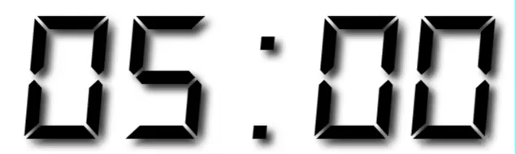
Exercise E
Open exercises/exerciseE.R
Explore the SAFI data from the example.

Slide 111
library(lubridate)
library(qdapTools)
safi <- read.csv("data/SAFI_clean.csv",
na = c("", "NULL", "NA"),
stringsAsFactors = FALSE)
safi$village <- factor(safi$village)
safi$respondent_wall_type <- factor(trimws(safi$respondent_wall_type)) safi$affect_conflicts <- factor(safi$affect_conflicts, ordered=TRUE,
levels=c("never","once","more_once","frequently"))
safi$interview_date <- ymd_hms(safi$interview_date)
safi$memb_assoc <- ifelse(is.na(safi$memb_assoc), NA,
ifelse(safi$memb_assoc == "yes", TRUE, FALSE))
month_indicators <- mtabulate(strsplit(safi$months_lack_food, ";"))
month_indicators <- month_indicators[,-10]
names(month_indicators) <- substr(names(month_indicators), 0, 3)
month_indicators <- month_indicators[,month.abb]
safi <- cbind(safi, month_indicators)
safi$months_lack_food_count <- apply(month_indicators, 1, sum)

Slide 112
apply(month_indicators, 2, sum)
which.max(apply(month_indicators, 2, sum))
table(safi$village)
tapply(safi$months_lack_food_count, safi$village, mean)
t.test(safi$months_lack_food_count[safi$village == "Chirodzo"],
safi$months_lack_food_count[safi$village == "Ruaca"])
barplot(table(safi$no_membrs))
hist(safi$no_membrs, breaks=1:20-.5, col="gray",
main="Family Size", xlab="Number of Members",
ylab="Number of Families")
boxplot(no_membrs~village, data=safi)
plot(y=safi$months_lack_food_count, x=safi$no_membrs) plot(y=jitter(safi$months_lack_food_count), x=jitter(safi$no_membrs),
col=rgb(.1, 0, 1, alpha=.3), pch=16)

Slide 113
Matrices
Matrix: 2D array, all elements of the same type
Index like a data frame:
matrix[row, column]
Can name rows and columns; but can't use $ notation
Special operators and functions for matrix operations
%*% multiplication
t() transpose
solve() inverse
https://www.statmethods.net/advstats/matrix.html
Notes:
You can do 3D with array, but used rarely — I didn't even know you could until recently, and I never used it in 15 years

Slide 114
Lists
Can hold objects of different types - numbers, character, data frames, matrices — anything
Can be nested
Elements can be named or not
Data frames are a special type of list.
Columns are the list elements

Slide 115
Lists
mylist <- list(title = "Research Bazaar",
numbers = 1:10, data = TRUE )
$title
[1] "Research Bazaar"
$numbers
[1] 1 2 3 4 5 6 7 8 9 10
$data
[1] TRUE

Slide 116
Lists
mylist <- list("Research Bazaar",
1:10, TRUE )
[[1]]
[1] "Research Bazaar"
[[2]]
[1] 1 2 3 4 5 6 7 8 9 10
[[3]]
[1] TRUE

Slide 117
Indexing Lists
> mylist <- list(title = "Research Bazaar",
+ numbers = 1:10, data = TRUE)
> mylist$numbers
[1] 1 2 3 4 5 6 7 8 9 10
> mylist[2]
$numbers
[1] 1 2 3 4 5 6 7 8 9 10
> mylist[[2]]
[1] 1 2 3 4 5 6 7 8 9 10
> mylist[[2]][3]
[1] 3

Slide 118
What is R? Why R?
RStudio Tour
Analysis Example Introduction
Basics and Data Types
Data Structures
Reading and Writing Files
Data Manipulation and Statistics
Visualization
Functions, Loops, and Conditionals

Slide 119
Data Import
read.csv defaults can be inconvenient
Consider using the readr package
Creates a tibble, which is a modified data frame
Can read from urls directly
Packages for
Reading files from Excel, Google Sheets, Stata, SPSS, SAS, etc.
Interfacing with databases
Special data types, like JSON, XML
Interfacing with APIs

Slide 120
Data Export
Writing is similar to reading:
write.csv(mtcars,
file="output/mtcars.csv",
row.names=FALSE)
Notes:
Directories need to exist before you write to them

Slide 121

Exercise
Write the iris data set to a file.

Slide 122
What is R? Why R?
RStudio Tour
Analysis Example Introduction
Basics and Data Types
Data Structures
Reading and Writing Files
Data Manipulation and Statistics
Visualization
Functions, Loops, and Conditionals

Slide 123
Dates
Sorting
Adding and Removing Columns
Recoding/Replacing Values
Aggregating and Apply Functions
Statistics

Slide 124
Dates
Dates should be Date objects
Sorting
Plotting
Date math: Differences, Addition, Subtraction
as.Date() defaults to year, month, date
"%Y-%m-%d" or "%Y/%m/%d"
Can specify other patterns
Notes:
If you work with time series data, there are special time series packages and data structures for aggregating, trends, lags, time series models, etc.

Slide 125
Dates: lubridate
Functions for different combinations: only need order
ymd(), ymd_hms(), dmy(), dmy_hms(), mdy(),...
ymd(20101215)
[1] "2010-12-15"
mdy("4/1/17")
[1] "2017-04-01"

Slide 126
Dates: lubridate
Get and set components
year(), month(), wday(), mday(), hour(),…
bday <- dmy("14/10/1979")
month(bday)
[1] 10
wday(bday, label = TRUE)
[1] Sun
Levels: Sun < Mon < Tue < Wed < Thu < Fri < Sat
Notes:
ways to handle durations, intervals, etc.

Slide 127
Exercise
Use the lubridate package
Create a variable with your birthday
today() gets you the current date
Subtract your birthday from today() to see how many days old you are

Slide 128
Sorting
> x <- c(3,6,2,3)
> sort(x)
[1] 2 3 3 6
> sort(x, decreasing=TRUE)
[1] 6 3 3 2
> order(x)
[1] 3 1 4 2
> x[order(x)]
[1] 2 3 3 6
> order(x, decreasing=TRUE)
[1] 2 1 4 3

Slide 129
Sorting
> safi[order(safi$no_membrs),
c("no_membrs", "village", "years_liv")]
no_membrs village years_liv
28 2 Ruaca 2
44 2 Chirodzo 6
47 2 Chirodzo 2
59 2 Chirodzo 60
1 3 God 4
6 3 God 3
26 3 Ruaca 20
31 3 Ruaca 2
37 3 Chirodzo 8
87 3 God 49
96 3 God 4

Slide 130
Sorting
> safi[order(safi$no_membrs, safi$years_liv),
c("no_membrs", "village", "years_liv")]
no_membrs village years_liv
28 2 Ruaca 2
47 2 Chirodzo 2
44 2 Chirodzo 6
59 2 Chirodzo 60
31 3 Ruaca 2
6 3 God 3
1 3 God 4
96 3 God 4
127 3 Ruaca 7

Slide 131
New Columns
Can add by naming them (adds to the end)
safi$small_family <- safi$no_membrs < 4

Slide 132
New Columns
Can also use cbind (column bind)
safi <- cbind(safi,
small_family = safi$no_membrs < 4)
cbind can be used with multiple columns or even data frames (need same number of rows)

Slide 133
Dropping Columns
Resave the data frame without the columns
match("instanceID", names(safi))
[1] 14
safi <- safi[,-match("instanceID", names(safi))]
safi <- safi[, !names(safi) %in%
c("instanceID","affect_conflicts")]

Slide 134
Subset
Subset for selecting rows or columns
subset(data.frame,
subset=condition for rows to keep,
select=columns to keep)
Don't have to quote variable names or prefix with name of the data frame

Slide 135
Subset
subset(safi,
subset=village=="God",
select=c(village, years_liv, rooms))
village years_liv rooms
1 God 4 1
2 God 9 1
3 God 15 1
4 God 6 1
5 God 40 1
6 God 3 1
7 God 38 1
11 God 20 1
12 God 20 3

Slide 136
Subset
subset(safi, select=-instanceID)
negative sign to exclude

Slide 137
Exercise
Read in the SAFI data again (exercise A)
Using subset, select the column respondent_wall_type for just the rows where the village is God
Select rows where no_membrs is > 2 and < 5
Exclude rows from the data where years_liv < 5
Find the 1 room houses made of burntbricks. Select just these two columns and the village.

Slide 138
Recoding Variables
> africa <- read.csv("data/africadata.csv", stringsAsFactors=FALSE)
> africa$region <- factor(africa$region)
> africa
country region gdp_2017 pop_2017 area rail road
1 Algeria north 99722535234 41063753 2381740 4691 113655.0
2 Angola central 31374141168 26655513 1246700 NA 51429.0
3 Benin west 4732594367 11458611 114760 758 19000.0
4 Botswana south 11443275218 2343981 581730 888 25798.0
5 Burkina Faso west 7013022439 19173322 274220 622 15271.6
6 Burundi east 1215021410 11936481 27830 NA 12322.0
7 Cameroon central 17940338306 24513689 475440 977 28857.0
8 Cape Verde west 1129263677 533468 4030 NA 1350.0
9 Central African Republic central 873967756 5098826 622980 NA 20278.0
10 Chad central 4150723012 14965482 1284000 NA 40000.0
11 Comoros east 294685870 825920 1861 NA 880.0
12 Congo, Dem. Rep. central 10774647957 82242685 2344860 3641 153497.0
13 Congo, Rep. central 5759941958 4866243 342000 795 17000.0
14 Cote d'Ivoire west 18395731842 23815886 322460 639 81996.0
15 Djibouti east 1194735681 911382 23200 781 3065.0
16 Egypt north 194839401082 95215102 1001450 5195 137430.0
17 Equatorial Guinea central 4555686010 894464 28050 NA 2880.0
18 Eritrea east 1091533809 5481906 117600 NA 4010.0
19 Ethiopia east 33810571855 104344901 1104300 781 44359.0
20 Gabon central 8387822439 1801232 267670 810 9170.0
21 Gambia west 723949020 2120418 11300 NA 3742.0
22 Ghana west 19695099069 28656723 238540 953 109515.0
23 Guinea west 5488850983 13290659 245860 NA 44348.0
24 Guinea-Bissau west 364874673 1932871 36130 NA 3455.0
25 Kenya east 28249427462 48466928 580370 1917 61947.0
26 Lesotho south 1508143226 2185159 30360 NA 5940.0
27 Liberia west 1052380371 4730437 111370 NA 10600.0

Slide 139
Recoding Variables
Make a new variable
africa$gdp_percap <- africa$gdp_2017/africa$pop_2017
Or overwrite the existing entirely
africa$road <- round(africa$road)
Or overwrite just part
africa$country[africa$country == "Congo, Dem. Rep."] <-
"DRC"

Slide 140
Recoding Variables
Assigning to subsets
> school <- c("Weinberg", "WCAS", "Weinberg", "WCAS", "McCormick", "McCormick")
> school[school=="WCAS"] <- "Weinberg"
> school
[1] "Weinberg" "Weinberg" "Weinberg" "Weinberg" "McCormick" "McCormick"

Slide 141
Recoding Variables
recode function
library(car)
africa$country <- recode(africa$country,
"'Congo, Dem. Rep.'='DRC'; 'Congo, Rep.'='Congo'")

Slide 142
Recoding Variables
ifelse function: coming in next section!

Slide 143
Exercise
x <- 20:30
Replace the prime numbers (23, 29) with NA by
1) subsetting
2) using recode
Hints:
1) Remember the %in% operator?
2) recode(x, "c(primes here) = NA")

Slide 144
x <- 20:30
x[x %in% c(23, 29)] <- NA
x <- recode(x, "c(23, 29)=NA")

Slide 145
Summarizing
summary(africa)
country region gdp_2017 pop_2017
Length:53 central: 9 Min. :1.180e+08 Min. : 97539
Class :character east :17 1st Qu.:2.055e+09 1st Qu.: 2568569
Mode :character north : 6 Median :6.069e+09 Median : 12159586
south : 5 Mean :2.190e+10 Mean : 23239288
west :16 3rd Qu.:1.794e+10 3rd Qu.: 26655513
Max. :2.104e+11 Max. :191835936
area rail road
Min. : 460 Min. : 259 Min. : 320
1st Qu.: 56790 1st Qu.: 781 1st Qu.: 10600
Median : 322460 Median : 953 Median : 19418
Mean : 555149 Mean : 2342 Mean : 44070
3rd Qu.: 923770 3rd Qu.: 2592 3rd Qu.: 58395
Max. :2381740 Max. :20500 Max. :362099
NA's :22

Slide 146
Tables
table(safi$village)
Chirodzo God Ruaca
39 43 49
table(safi$village, safi$respondent_wall_type)
burntbricks cement muddaub sunbricks
Chirodzo 22 0 16 1
God 19 0 15 9
Ruaca 26 1 15 7
tmp <- table(safi$village, safi$respondent_wall_type)
tmp["God", "muddaub"]
[1] 15

Slide 147
Tables
prop.table(table(safi$village, safi$respondent_wall_type), 1)
burntbricks cement muddaub sunbricks
Chirodzo 0.56410256 0.00000000 0.41025641 0.02564103
God 0.44186047 0.00000000 0.34883721 0.20930233
Ruaca 0.53061224 0.02040816 0.30612245 0.14285714
Notes:
Tables have margins - 1 is rows, 2 is columns
Also: prop.table

Slide 148
Aggregating
> names(africa)
[1] "country" "region" "gdp_2017" "pop_2017" "area" "rail" "road"
aggregate(africa[,-1:-2], by=list(africa$region),
FUN=mean, na.rm=TRUE)
Group.1 gdp_2017 pop_2017 area rail road
1 central 9331957724 17915179 734740.0 1555.750 35936.78
2 east 9932960738 23673746 374060.9 1496.100 33772.00
3 north 74937116604 38598350 1272041.2 3694.600 70666.33
4 south 46727283148 12770885 534566.0 6017.500 88313.80
5 west 14048650336 23284215 384133.1 1108.375 35786.48

Slide 149
Aggregating
aggregate(africa$pop_2017, by=list(africa$region),
FUN=mean, na.rm=TRUE)
Group.1 x
1 central 17915179
2 east 23673746
3 north 38598350
4 south 12770885
5 west 23284215

Slide 150
Aggregating
aggregate(africa$pop_2017,
by=list(region=africa$region),
FUN=mean, na.rm=TRUE)
region x
1 central 17915179
2 east 23673746
3 north 38598350
4 south 12770885
5 west 23284215

Slide 151
Exercise
Read in the SAFI data again (exercise A). Run the line to factor respondent_wall_type.
Using aggregate, find:
1) the average family size per village
2) average number of rooms in the dwelling
per wall type and village (group on both)
Bonus: sort the second result by village, then wall type

Slide 152
> aggregate(safi$no_membrs, by=list(safi$village), mean)
Group.1 x
1 Chirodzo 7.076923
2 God 6.860465
3 Ruaca 7.571429
> aggregate(safi$rooms, by=list(safi$village, safi$respondent_wall_type), mean, na.rm=TRUE)
Group.1 Group.2 x
1 Chirodzo burntbricks 2.590909
2 God burntbricks 1.684211
3 Ruaca burntbricks 2.000000
4 Ruaca cement 3.000000
...
> tmp<- aggregate(safi$rooms, by=list(safi$village, safi$respondent_wall_type), mean, na.rm=TRUE)
> tmp[order(tmp$Group.1, tmp$Group.2),]
Group.1 Group.2 x
1 Chirodzo burntbricks 2.590909
5 Chirodzo muddaub 1.187500
8 Chirodzo sunbricks 1.000000
2 God burntbricks 1.684211
6 God muddaub 1.266667

Slide 153
Apply
apply(X, MARGIN, FUN, ...)
MARGIN=1 - rows
MARGIN=2 - columns
apply(africa[,-1:-2], 2, mean, na.rm=TRUE)
gdp_2017 pop_2017 area rail road
2.190350e+10 2.323929e+07 5.551491e+05 2.341742e+03 4.406992e+04

Slide 154
Apply
> month_indicators
Jan Feb Mar Apr May Jun Jul Aug Sep Oct Nov Dec
1 1 0 0 0 0 0 0 0 0 0 0 0
2 1 0 0 0 0 0 0 0 1 1 1 1
3 1 1 1 0 0 0 0 0 0 1 1 1
4 0 0 0 0 0 0 0 0 1 1 1 1
...
> apply(month_indicators, 1, sum)
[1] 1 5 6 4 4 3 1 1 2 4 2 2 3 6 11 2 2 2 3
[20] 2 6 9 0 2 3 0 0 3 2 2 0 0 0 2 5 0 3 1
[39] 1 3 2 3 5 2 0 3 0 6 3 7 2 4 1 3 2 0 0
[58] 0 0 0 3 4 4 3 3 0 0 0 0 0 4 3 3 0 2 5
[77] 0 1 2 0 4 0 0 3 0 1 1 3 6 6 3 0 3 2 2
[96] 3 3 2 3 0 3 3 3 5 0 0 3 5 0 0 4 3 4 0
[115] 2 3 3 1 0 2 3 3 4 1 3 3 3 0 3 2 2

Slide 155
Apply
> apply(month_indicators, 2, sum)
Jan Feb Mar Apr May Jun Jul Aug Sep Oct Nov Dec
42 21 7 2 1 4 5 17 33 59 71 42
> which.max(apply(month_indicators, 2, sum))
Nov
11

Slide 156
tapply
tapply(X, INDEX, FUN = NULL, …)
tapply(safi$months_lack_food_count, safi$village, mean)
Chirodzo God Ruaca
2.102564 3.000000 1.897959

Slide 157
tapply
aggregate(africa$pop_2017, list(africa$region), mean)
Group.1 x
1 central 17915179
2 east 23673746
3 north 38598350
4 south 12770885
5 west 23284215
tapply(africa$pop_2017, africa$region, mean)
central east north south west
17915179 23673746 38598350 12770885 23284215

Slide 158
tapply
aggregate(safi$rooms,
list(safi$village, safi$respondent_wall_type),
mean, na.rm=TRUE)
tapply(safi$rooms,
list(safi$village, safi$respondent_wall_type),
mean, na.rm=TRUE)
burntbricks cement muddaub sunbricks
Chirodzo 2.590909 NA 1.187500 1.000000
God 1.684211 NA 1.266667 1.666667
Ruaca 2.000000 3 1.333333 1.428571

Slide 159
library(lubridate)
library(qdapTools)
safi <- read.csv("data/SAFI_clean.csv",
na = c("", "NULL", "NA"),
stringsAsFactors = FALSE)
safi$village <- factor(safi$village)
safi$respondent_wall_type <- factor(trimws(safi$respondent_wall_type)) safi$affect_conflicts <- factor(safi$affect_conflicts, ordered=TRUE,
levels=c("never","once","more_once","frequently"))
safi$interview_date <- ymd_hms(safi$interview_date)
safi$memb_assoc <- ifelse(is.na(safi$memb_assoc), NA,
ifelse(safi$memb_assoc == "yes", TRUE, FALSE))
month_indicators <- mtabulate(strsplit(safi$months_lack_food, ";"))
month_indicators <- month_indicators[,-10]
names(month_indicators) <- substr(names(month_indicators), 0, 3)
month_indicators <- month_indicators[,month.abb]
safi <- cbind(safi, month_indicators)
safi$months_lack_food_count <- apply(month_indicators, 1, sum)

Slide 160
apply(month_indicators, 2, sum)
which.max(apply(month_indicators, 2, sum))
table(safi$village)
tapply(safi$months_lack_food_count, safi$village, mean)
t.test(safi$months_lack_food_count[safi$village == "Chirodzo"],
safi$months_lack_food_count[safi$village == "Ruaca"])
barplot(table(safi$no_membrs))
hist(safi$no_membrs, breaks=1:20-.5, col="gray",
main="Family Size", xlab="Number of Members",
ylab="Number of Families")
boxplot(no_membrs~village, data=safi)
plot(y=safi$months_lack_food_count, x=safi$no_membrs) plot(y=jitter(safi$months_lack_food_count), x=jitter(safi$no_membrs),
col=rgb(.1, 0, 1, alpha=.3), pch=16)

Slide 161
Statistics
mean(x)
median(x)
cor(x, y)
var(x)
sd(x)

Slide 162
Statistics
> cor(africa[,-1:-2])
gdp_2017 pop_2017 area rail road
gdp_2017 1.0000000 0.6660203 0.3838423 NA 0.8159500
pop_2017 0.6660203 1.0000000 0.4618159 NA 0.6359208
area 0.3838423 0.4618159 1.0000000 NA 0.4943773
rail NA NA NA 1 NA
road 0.8159500 0.6359208 0.4943773 NA 1.0000000
> cor(africa[,-1:-2], use="pairwise")
gdp_2017 pop_2017 area rail road
gdp_2017 1.0000000 0.6660203 0.3838423 0.7676654 0.8159500
pop_2017 0.6660203 1.0000000 0.4618159 0.2834323 0.6359208
area 0.3838423 0.4618159 1.0000000 0.4003553 0.4943773
rail 0.7676654 0.2834323 0.4003553 1.0000000 0.8474765
road 0.8159500 0.6359208 0.4943773 0.8474765 1.0000000

Slide 163
T Test
t.test(safi$months_lack_food_count[safi$village == "Chirodzo"],
safi$months_lack_food_count[safi$village == "Ruaca"])
Welch Two Sample t-test
data: safi$months_lack_food_count[safi$village == "Chirodzo"] and safi$months_lack_food_count[safi$village == "Ruaca"]
t = 0.53747, df = 74.124, p-value = 0.5926
alternative hypothesis: true difference in means is not equal to 0
95 percent confidence interval:
-0.5539014 0.9631113
sample estimates:
mean of x mean of y
2.102564 1.897959

Slide 164
T Test
t1 <- t.test(safi$months_lack_food_count[safi$village == "Chirodzo"],
safi$months_lack_food_count[safi$village == "Ruaca"])
names(t1)
[1] "statistic" "parameter" "p.value" "conf.int" "estimate"
[6] "null.value" "alternative" "method" "data.name"
t1$statistic
t
0.5374679
t1$p.value
[1] 0.5925544

Slide 165
Exercise
Using the SAFI data, are families in village God larger than families in village Ruaca?
Notes:
Answer: no

Slide 166
Regression
africa <- read.csv("data/africadata.csv")
lm(road ~ pop_2017 + gdp_2017, data=africa)
Call:
lm(formula = road ~ pop_2017 + gdp_2017, data = africa)
Coefficients:
(Intercept) pop_2017 gdp_2017
1.517e+04 3.084e-04 9.920e-07

Slide 167
Regression
lm(y ~ x1 + x2, data=data_frame_name)
Intercept (constant) term gets added
Don't need to quote or prefix column names

Slide 168
Regression Summary
reg1 <- lm(road ~ pop_2017 + gdp_2017, data=africa)
summary(reg1)
Call:
lm(formula = road ~ pop_2017 + gdp_2017, data = africa)
Residuals:
Min 1Q Median 3Q Max
-100394 -14841 -8052 3801 121130
Coefficients:
Estimate Std. Error t value Pr(>|t|)
(Intercept) 1.517e+04 5.993e+03 2.532 0.0145 *
pop_2017 3.084e-04 1.987e-04 1.553 0.1268
gdp_2017 9.920e-07 1.506e-07 6.588 2.65e-08 ***
---
Signif. codes: 0 ‘***’ 0.001 ‘**’ 0.01 ‘*’ 0.05 ‘.’ 0.1 ‘ ’ 1
Residual standard error: 35670 on 50 degrees of freedom
Multiple R-squared: 0.6811, Adjusted R-squared: 0.6684
F-statistic: 53.41 on 2 and 50 DF, p-value: 3.889e-13

Slide 169
Regression Summary
reg1 <- lm(road ~ pop_2017 + gdp_2017, data=africa)
summary(reg1)
Call:
lm(formula = road ~ pop_2017 + gdp_2017, data = africa)
Residuals:
Min 1Q Median 3Q Max
-100394 -14841 -8052 3801 121130

Slide 170
Regression Summary
reg1 <- lm(road ~ pop_2017 + gdp_2017, data=africa)
summary(reg1)
Coefficients:
Estimate Std. Error t value Pr(>|t|)
(Intercept) 1.517e+04 5.993e+03 2.532 0.0145 *
pop_2017 3.084e-04 1.987e-04 1.553 0.1268
gdp_2017 9.920e-07 1.506e-07 6.588 2.65e-08 ***
---
Signif. codes: 0 ‘***’ 0.001 ‘**’ 0.01 ‘*’ 0.05 ‘.’ 0.1 ‘ ’ 1

Slide 171
Regression Summary
reg1 <- lm(road ~ pop_2017 + gdp_2017, data=africa)
summary(reg1)
Residual standard error: 35670 on 50 degrees of freedom
Multiple R-squared: 0.6811, Adjusted R-squared: 0.6684
F-statistic: 53.41 on 2 and 50 DF, p-value: 3.889e-13

Slide 172
Regression Objects
> names(reg1)
[1] "coefficients" "residuals" "effects"
[4] "rank" "fitted.values" "assign"
[7] "qr" "df.residual" "xlevels"
[10] "call" "terms" "model"
> names(summary(reg1))
[1] "call" "terms" "residuals"
[4] "coefficients" "aliased" "sigma"
[7] "df" "r.squared" "adj.r.squared"
[10] "fstatistic" "cov.unscaled"

Slide 173
Character/Factor/Logical in lm()
reg2 <- lm(road ~ pop_2017 + gdp_2017 + region, data=africa)
summary(reg2)
Coefficients:
Estimate Std. Error t value Pr(>|t|)
(Intercept) 2.043e+04 1.178e+04 1.735 0.0894 .
pop_2017 2.887e-04 2.092e-04 1.380 0.1742
gdp_2017 1.107e-06 1.791e-07 6.184 1.53e-07 ***
regioneast -4.493e+03 1.419e+04 -0.317 0.7530
regionnorth -4.389e+04 2.027e+04 -2.166 0.0355 *
regionsouth 1.245e+04 2.056e+04 0.606 0.5478
regionwest -6.924e+03 1.432e+04 -0.484 0.6310

Slide 174
Character/Factor/Logical in lm()
> table(africa$region)
central east north south west
9 17 6 5 16
Coefficients:
Estimate Std. Error t value Pr(>|t|)
(Intercept) 2.043e+04 1.178e+04 1.735 0.0894 .
pop_2017 2.887e-04 2.092e-04 1.380 0.1742
gdp_2017 1.107e-06 1.791e-07 6.184 1.53e-07 ***
regioneast -4.493e+03 1.419e+04 -0.317 0.7530
regionnorth -4.389e+04 2.027e+04 -2.166 0.0355 *
regionsouth 1.245e+04 2.056e+04 0.606 0.5478
regionwest -6.924e+03 1.432e+04 -0.484 0.6310

Slide 175
Prediction
> predict(reg1, africa)
1 2 3 4 5 6 7 8
126764.61 54518.55 23402.63 27248.31 28044.37 20060.58 40531.52 16458.32
9 10 11 12 13 14 15 16
17613.22 23907.08 15720.62 51229.25 22388.39 40768.04 16639.83 237823.61
17 18 19 20 21 22 23 24
19968.69 17947.20 80898.27 24049.88 16545.73 43550.15 24717.92 16131.68
25 26 27 28 29 30 31 32
58146.41 17343.62 17676.58 34169.52 29237.12 24442.74 26954.44 18527.76
33 34 35 36 37 38 39 40
24027.01 102598.67 37998.99 23993.94 25920.52 213084.67 24901.98 15403.75
41 42 43 44 45 46 47 48
29774.56 16455.21 19351.85 18804.40 240968.75 55287.57 17776.99 63557.34
49 50 51 52 53
19758.43 51857.54 45500.02 29023.89 26232.97

Slide 176
Formula Syntax
Symbol | Example | Description
~ | y ~ x1 | Defines the formula (necessary to create a formula object)
+ | y ~ x1 + x2 | Include the variable
- | y ~ -1 +x1 | Delete a term, usually a 1 for the intercept
: | y ~ x1 + x1:x2 | Interaction term
* | y ~ x1*x2 | Interaction between the variables and each individually; same as y ~ x1 + x2 + x1:x2
^ | y ~ (x1, x2, x3)^3 | Include variables and all interactions, up to 3-way interactions
I() | y ~ I(x1^2) | Wrapper for transforming variables without having to create a new variable
poly() | y ~ poly(x1, 2) | Creates polynomial terms up to the degree specified

Slide 177
Other Regression Models
function glm: generalized linear models
logit, probit
poisson
packages nlme and lme4: non-linear mixed effects models
random and fixed effects, hierarchical
Other specialized packages

Slide 178
library(lubridate)
library(qdapTools)
safi <- read.csv("data/SAFI_clean.csv",
na = c("", "NULL", "NA"),
stringsAsFactors = FALSE)
safi$village <- factor(safi$village)
safi$respondent_wall_type <- factor(trimws(safi$respondent_wall_type)) safi$affect_conflicts <- factor(safi$affect_conflicts, ordered=TRUE,
levels=c("never","once","more_once","frequently"))
safi$interview_date <- ymd_hms(safi$interview_date)
safi$memb_assoc <- ifelse(is.na(safi$memb_assoc), NA,
ifelse(safi$memb_assoc == "yes", TRUE, FALSE))
month_indicators <- mtabulate(strsplit(safi$months_lack_food, ";"))
month_indicators <- month_indicators[,-10]
names(month_indicators) <- substr(names(month_indicators), 0, 3)
month_indicators <- month_indicators[,month.abb]
safi <- cbind(safi, month_indicators)
safi$months_lack_food_count <- apply(month_indicators, 1, sum)

Slide 179
apply(month_indicators, 2, sum)
which.max(apply(month_indicators, 2, sum))
table(safi$village)
tapply(safi$months_lack_food_count, safi$village, mean)
t.test(safi$months_lack_food_count[safi$village == "Chirodzo"],
safi$months_lack_food_count[safi$village == "Ruaca"])
barplot(table(safi$no_membrs))
hist(safi$no_membrs, breaks=1:20-.5, col="gray",
main="Family Size", xlab="Number of Members",
ylab="Number of Families")
boxplot(no_membrs~village, data=safi)
plot(y=safi$months_lack_food_count, x=safi$no_membrs) plot(y=jitter(safi$months_lack_food_count), x=jitter(safi$no_membrs),
col=rgb(.1, 0, 1, alpha=.3), pch=16)

Slide 180
What is R? Why R?
RStudio Tour
Analysis Example Introduction
Basics and Data Types
Data Structures
Reading and Writing Files
Data Manipulation and Statistics
Visualization
Functions, Loops, and Conditionals

Slide 181
Plotting Systems
Base R
No package required
What we're learning today
Different functions for different types of plots
ggplot2
Great for showing groups
Attractive defaults
Consistent procedure for all plots
Separate workshop
Other systems, specialized packages

Slide 182
Base R Plot
plot(y=safi$months_lack_food_count, x=safi$no_membrs)

Slide 183
Plot Labels
plot(y=safi$months_lack_food_count, x=safi$no_membrs,
xlab="Number in Family", ylab="Months without Food",
main="SAFI Data")

Slide 184
Plot Colors, Points
plot(y=safi$months_lack_food_count, x=safi$no_membrs,
xlab="Number in Family", ylab="Months without Food",
main="SAFI Data", pch=16, col="red")

Slide 185
RGB Colors
plot(y=safi$months_lack_food_count, x=safi$no_membrs,
xlab="Number in Family", ylab="Months without Food",
main="SAFI Data", pch=16, cex=3,
col=rgb(.1, 0, 1, alpha=.3))

Slide 186
Jittering Points
plot(y=jitter(safi$months_lack_food_count),
x=jitter(safi$no_membrs),
col=rgb(.1, 0, 1, alpha=.3), pch=16)

Slide 187
Identifying Points
plot(y=safi$months_lack_food_count, x=safi$no_membrs)
identify(y=safi$months_lack_food_count, x=safi$no_membrs,
labels=safi$key_ID)

Slide 188
Identifying Points
plot(y=safi$months_lack_food_count, x=safi$no_membrs)
identify(y=safi$months_lack_food_count, x=safi$no_membrs,
labels=safi$village)

Slide 189
Line Plot
plot(x=longley$Year, y=longley$Population,
type="l")

Slide 190
Line Plot
plot(x=longley$Year, y=longley$Population,
lwd=2, type="b")

Slide 191
Histogram
hist(safi$no_membrs, col="gray",
main="Family Size",
xlab="Number of Members",
ylab="Number of Families")

Slide 192
Histogram
hist(safi$no_membrs, breaks=1:20-.5, col="gray",
main="Family Size", xlab="Number of Members",
ylab="Number of Families")

Slide 193
Histogram
hist(safi$no_membrs, breaks=20, col="gray",
main="Family Size", xlab="Number of Members",
ylab="Number of Families")

Slide 194
Bar Plot
barplot(table(safi$village))

Slide 195
Box Plot
boxplot(no_membrs~village, data=safi)

Slide 196
Formula Syntax
y ~ x
y ~ x1 + x2

Slide 197
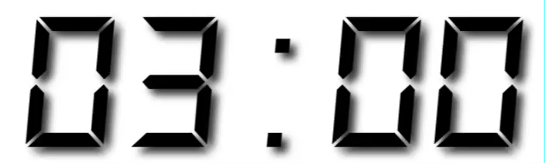
Exercise
Make a histogram of a different variable
in the SAFI data.
Make another plot using the SAFI data.
Label it appropriately.
Use cheat sheets linked from GitHub repo if needed.

Slide 198
library(lubridate)
library(qdapTools)
safi <- read.csv("data/SAFI_clean.csv",
na = c("", "NULL", "NA"),
stringsAsFactors = FALSE)
safi$village <- factor(safi$village)
safi$respondent_wall_type <- factor(trimws(safi$respondent_wall_type)) safi$affect_conflicts <- factor(safi$affect_conflicts, ordered=TRUE,
levels=c("never","once","more_once","frequently"))
safi$interview_date <- ymd_hms(safi$interview_date)
safi$memb_assoc <- ifelse(is.na(safi$memb_assoc), NA,
ifelse(safi$memb_assoc == "yes", TRUE, FALSE))
month_indicators <- mtabulate(strsplit(safi$months_lack_food, ";"))
month_indicators <- month_indicators[,-10]
names(month_indicators) <- substr(names(month_indicators), 0, 3)
month_indicators <- month_indicators[,month.abb]
safi <- cbind(safi, month_indicators)
safi$months_lack_food_count <- apply(month_indicators, 1, sum)

Slide 199
apply(month_indicators, 2, sum)
which.max(apply(month_indicators, 2, sum))
table(safi$village)
tapply(safi$months_lack_food_count, safi$village, mean)
t.test(safi$months_lack_food_count[safi$village == "Chirodzo"],
safi$months_lack_food_count[safi$village == "Ruaca"])
barplot(table(safi$no_membrs))
hist(safi$no_membrs, breaks=1:20-.5, col="gray",
main="Family Size", xlab="Number of Members",
ylab="Number of Families")
boxplot(no_membrs~village, data=safi)
plot(y=safi$months_lack_food_count, x=safi$no_membrs) plot(y=jitter(safi$months_lack_food_count), x=jitter(safi$no_membrs),
col=rgb(.1, 0, 1, alpha=.3), pch=16)

Slide 200
What is R? Why R?
RStudio Tour
Analysis Example Introduction
Basics and Data Types
Data Structures
Reading and Writing Files
Data Manipulation and Statistics
Visualization
Functions, Loops, and Conditionals
Notes:
Loops and conditionals are standard parts of programming languages. We looped some before when using the apply functions - we just didn't do it explicitly — the functions took care if it for us.

Slide 201
Functions
You can write your own!

Slide 202
Functions
my_function <- function(x) {
do something
return()
}
my_function(3)
Result of the function

Slide 203
Functions
fahr_to_kelvin <- function(temp) {
kelvin <- ((temp - 32) * (5 / 9)) + 273.15
return(kelvin)
}
> fahr_to_kelvin(212)
[1] 373.15

Slide 204
Functions: Default Values
increment <- function(a, step=1) {
return(a+step)
}
increment(3)
[1] 4
increment(3, 2)
[1] 5

Slide 205
Scope
x <- 5
curious <- function(x) {
x <- x + 1
return(x)
}
curious(10)
x
11
5

Slide 206
Source
source("my_functions.r")
Read and run other code
Creates objects, doesn't create output
Notes:
You can put functions (or other code) in a separate file and use source to run that code in your environment

Slide 207
Exercise
fahr_to_kelvin <- function(temp) {
kelvin <- ((temp - 32) * (5 / 9)) + 273.15
return(kelvin)
}
Write kelvin_to_fahr to reverse the above function
Test your function by calling fahr_to_kelvin, then kelvin_to_fahr

Slide 208
If Statement
if (condition) {
do_something
}
Condition has to
evaluate to single
TRUE or FALSE value
age <- 24
if (age >= 21) {
print("Cheers")
}

Slide 209
If-Else Statement
if (condition) {
do_something
} else {
do_something_else
}

Slide 210
If-Else Statement
if (age >= 21) {
print("Cheers")
} else {
print("Not old enough")
}

Slide 211
If-Else Ladder
if (condition) {
do_something
} else if (other_condition){
do_something_else
} else {
do_default
}

Slide 212
If-Else Ladder
if (age >= 21) {
print("Cheers")
} else if (age >= 18) {
print("Please vote")
} else {
print("Not old enough")
}
Notes:
What happens when age is 19?

Slide 213
If-Else
age <- c(20,21,24,18,17)
if (age >= 21) {
print("Cheers")
} else if (age >= 18) {
print("Please vote")
} else {
print("Not old enough")
}

Slide 214
Warning!
[1] "Please vote"
Warning messages:
1: In if (age >= 21) { :
the condition has length > 1 and only the first element will be used
2: In if (age >= 18) { :
the condition has length > 1 and only the first element will be used

Slide 215
ifelse
ifelse(condition, value if TRUE, value if FALSE)
Vectorized if-else statement: do many comparisons at once

Slide 216
ifelse
> x<-rnorm(5)
> x
[1] -0.49861 2.07395 -0.14074 -0.11938 2.39145
> ifelse(x > 0, "pos", "neg")
[1] "neg" "pos" "neg" "neg" "pos"

Slide 217
ifelse
> ages <- c(19, 22, 24, 20, 18, 17, 23, 24)
> can_drink <- ages >= 21
> can_drink
[1] FALSE TRUE TRUE FALSE FALSE FALSE TRUE TRUE
> status <- ifelse(ages >= 18, "adult", "minor")
> status
[1] "adult" "adult" "adult" "adult" "adult" "minor" "adult" "adult"

Slide 218
Exercise
Write an if-else statement that prints the maximum of two variables, a or b.
a <- 5
b <- 6
Use ifelse to return the pairwise maximum of two vectors, v1 and v2.
v1 <- rnorm(10)
v2 <- rnorm(10)

Slide 219
library(lubridate)
library(qdapTools)
safi <- read.csv("data/SAFI_clean.csv",
na = c("", "NULL", "NA"),
stringsAsFactors = FALSE)
safi$village <- factor(safi$village)
safi$respondent_wall_type <- factor(trimws(safi$respondent_wall_type)) safi$affect_conflicts <- factor(safi$affect_conflicts, ordered=TRUE,
levels=c("never","once","more_once","frequently"))
safi$interview_date <- ymd_hms(safi$interview_date)
safi$memb_assoc <- ifelse(is.na(safi$memb_assoc), NA,
ifelse(safi$memb_assoc == "yes", TRUE, FALSE))
month_indicators <- mtabulate(strsplit(safi$months_lack_food, ";"))
month_indicators <- month_indicators[,-10]
names(month_indicators) <- substr(names(month_indicators), 0, 3)
month_indicators <- month_indicators[,month.abb]
safi <- cbind(safi, month_indicators)
safi$months_lack_food_count <- apply(month_indicators, 1, sum)
Notes:
ifelse

Slide 220
a <- 5
b <- 6
if (a >= b) {
print(a)
} else {
print(b)
}
v1 <- rnorm(10)
v2 <- rnorm(10)
ifelse(v1 >= v2, v1, v2)

Slide 221
for Loop
> for (i in 1:5) {
+ print(i)
+ }
[1] 1
[1] 2
[1] 3
[1] 4
[1] 5
Notes:
For large data sets, you don't want to loop through rows — you'll run out of memory, and it will take forever. The apply functions, or other mapping functions that apply a function to a series of inputs, are a better choice. There are times when it's useful to use a loop though.

Slide 222
for Loop
for (variable in vector) {
do something
}

Slide 223
for Loop
price <- c(3, 5, 2, 4, 10)
total <- 0
for (p1 in price) {
total <- total + p1
}
total
24

Slide 224
for Loop
for (idx in 1:nrow(mtcars)) {
print(rownames(mtcars)[idx])
if (mtcars$mpg[idx] > 25) {
print("fuel efficient")
} else {
print("not efficient")
}
}

Slide 225
[1] "Mazda RX4"
[1] "not efficient"
[1] "Mazda RX4 Wag"
[1] "not efficient"
[1] "Datsun 710"
[1] "not efficient"
[1] "Hornet 4 Drive"
[1] "not efficient"
[1] "Hornet Sportabout"
[1] "not efficient"
[1] "Valiant"
[1] "not efficient"
[1] "Duster 360"
[1] "not efficient"
[1] "Merc 240D"
[1] "not efficient"
[1] "Merc 230"
[1] "not efficient"
[1] "Merc 280"
[1] "not efficient"
[1] "Merc 280C"
[1] "not efficient"
[1] "Merc 450SE"
[1] "not efficient"
[1] "Merc 450SL"
[1] "not efficient"
[1] "Merc 450SLC"
[1] "not efficient"
[1] "Cadillac Fleetwood"
[1] "not efficient"
[1] "Lincoln Continental"
[1] "not efficient"
[1] "Chrysler Imperial"
[1] "not efficient"
[1] "Fiat 128"
[1] "fuel efficient"

Slide 226
for Loop
for (i in 1:5) {
for (j in c('a', 'b', 'c', 'd', 'e')) {
print(paste(i, j))
}
}

Slide 227
[1] "1 a"
[1] "1 b"
[1] "1 c"
[1] "1 d"
[1] "1 e"
[1] "2 a"
[1] "2 b"
[1] "2 c"
[1] "2 d"
[1] "2 e"
[1] "3 a"
[1] "3 b"
[1] "3 c"
[1] "3 d"
[1] "3 e"
[1] "4 a"
[1] "4 b"
[1] "4 c"
[1] "4 d"
[1] "4 e"
[1] "5 a"
[1] "5 b"
[1] "5 c"
[1] "5 d"
[1] "5 e"

Slide 228
for Loop
output_vector <- c()
for (i in 1:5) {
for (j in c('a', 'b', 'c', 'd', 'e')) {
temp_output <- paste(i, j)
output_vector <- c(output_vector, temp_output)
}
}
output_vector
[1] "1 a" "1 b" "1 c" "1 d" "1 e" "2 a" "2 b" "2 c" "2 d" "2 e" "3 a"
[12] "3 b" "3 c" "3 d" "3 e" "4 a" "4 b" "4 c" "4 d" "4 e" "5 a" "5 b"
[23] "5 c" "5 d" "5 e"

Slide 229
for Loop
for (animal in c("cow", "bear", "dog")) {
print(paste("A", animal, "has 4 legs"))
}

Slide 230
while Loop
while (condition is TRUE) {
do something
}

Slide 231
while Loop
z <- 1
while(z > 0.1){
z <- runif(1)
print(z)
}
[1] 0.6675658
[1] 0.9209164
[1] 0.0449896

Slide 232
Exercise
Write a function with a for loop to print out a multiplication table (up to 10) for an input number.
Example output for input of 8:
8 x 1 = 8
8 x 2 = 16
8 x 3 = 24
…
8 x 10 = 80

Slide 233
mult_table <- function(input) {
for (i in 1:10) {
print(paste(input,"x",i,"=",input*i))
}
}
mult_table(8)

Slide 234
Wrap Up

Slide 235
library(lubridate)
library(qdapTools)
safi <- read.csv("data/SAFI_clean.csv",
na = c("", "NULL", "NA"),
stringsAsFactors = FALSE)
safi$village <- factor(safi$village)
safi$respondent_wall_type <- factor(trimws(safi$respondent_wall_type)) safi$affect_conflicts <- factor(safi$affect_conflicts, ordered=TRUE,
levels=c("never","once","more_once","frequently"))
safi$interview_date <- ymd_hms(safi$interview_date)
safi$memb_assoc <- ifelse(is.na(safi$memb_assoc), NA,
ifelse(safi$memb_assoc == "yes", TRUE, FALSE))
month_indicators <- mtabulate(strsplit(safi$months_lack_food, ";"))
month_indicators <- month_indicators[,-10]
names(month_indicators) <- substr(names(month_indicators), 0, 3)
month_indicators <- month_indicators[,month.abb]
safi <- cbind(safi, month_indicators)
safi$months_lack_food_count <- apply(month_indicators, 1, sum)
Notes:
ifelse

Slide 236
apply(month_indicators, 2, sum)
which.max(apply(month_indicators, 2, sum))
table(safi$village)
tapply(safi$months_lack_food_count, safi$village, mean)
t.test(safi$months_lack_food_count[safi$village == "Chirodzo"],
safi$months_lack_food_count[safi$village == "Ruaca"])
barplot(table(safi$no_membrs))
hist(safi$no_membrs, breaks=1:20-.5, col="gray",
main="Family Size", xlab="Number of Members",
ylab="Number of Families")
boxplot(no_membrs~village, data=safi)
plot(y=safi$months_lack_food_count, x=safi$no_membrs) plot(y=jitter(safi$months_lack_food_count), x=jitter(safi$no_membrs),
col=rgb(.1, 0, 1, alpha=.3), pch=16)

Slide 237
Challenge Exercise
What does mtabulate do?
Can you find another way to do the same thing? Another function or snippet of code?

Slide 238
https://stackoverflow.com/questions/16267552/dummy-variables-from-a-string-variable
surveymonths <- unique(unlist(strsplit(safi$months_lack_food, ";")))
results <- t(sapply(strsplit(safi$months_lack_food, ";"),
`%in%`, x=surveymonths)) + 0
dimnames(results) <- list(seq(nrow(results)), seq(ncol(results)))
install.packages("splitstackshape")
library(splitstackshape)
concat.split.expanded(safi, "months_lack_food", ";", fill=0,
type="character")
Notes:
If you put any operator in back ticks, like `%in%`, you can use it as a function.

Slide 239
That's All
Questions?

Slide 240
Northwestern R User Group
http://bit.ly/nu_r

Slide 242



